Slide 1

Automotive Technology:
A Systems Approach, 8e
Chapter 3: Basic Theories and Math
Rob Thompson and Jack Erjavec, Automotive Technology: A Systems Approach, 8th Edition. © 2025 Cengage. All Rights Reserved. May not be scanned, copied or duplicated, or posted to a publicly accessible website, in whole or in part.

Slide 2
Chapter Objectives (1 of 2)
03.01 Describe the states in which all matter exists.
03.02 Explain what energy is and how energy is converted.
03.03 Explain how volume, ratios, and proportions are used in automotive service.
03.04 Explain the forces that influence the design and operation of an automobile.
03.05 Describe and apply Newton's laws of motion to an automobile.
03.06 Define work and how it applies to vehicle operation.

Slide 3
Chapter Objectives (2 of 2)
03.07 Describe the origins of sound, noise, and vibration.
03.08 Explain the laws of hydraulics.
03.09 Explain the behavior of gases.
03.10 Identify types of heat transfer.
03.11 Explain how chemical properties relate to automotive systems.
03.12 Describe the properties of electricity and electromagnetism.

Slide 4
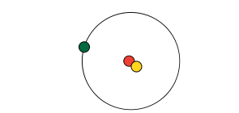
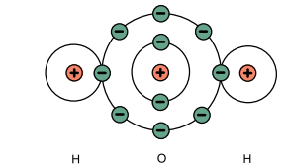
Matter
Matter is anything that occupies space.
All matter is made up of countless tiny particles called atoms.
A substance with only one type of atom is referred to as an element.
Atomic structure
  Protons are positively charged particles.
  Electrons are negatively charged particles.
  Neutrons have no electrical charge.

Slide 5
Behavior of the States
03-01 Describe the states in which all matter exits.
The particles of a solid are held together in a rigid structure.
When a solid dissolves into a liquid, its particles break away from the solid structure and mix evenly in a liquid, forming a solution.
When a liquid is heated, most will evaporate, which means atoms or molecules break free from the body of liquid to become gas particles.
Absorption and Adsorption
  Not all solids dis­solve in a liquid; rather, the liquid is either absorbed or adsorbed.
  his is adsorption. Materi­als that absorb fluids are permeable substances. Impermeable substances, such as glass, adsorb fluids.

Slide 6
Energy (1 of 2)
03-02 Explain what energy is and how energy is converted.
Energy may be defined as the ability to do work.
Because all matter consists of atoms and molecules in constant motion, all matter has energy.
Energy is not matter, but it affects the behavior of mat­ter and everything that happens requires energy, and energy comes in many forms.

Slide 7
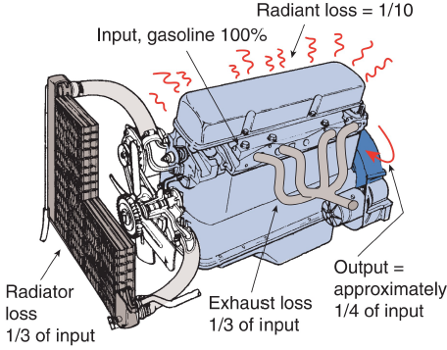
Energy (2 of 2)
Engine efficiency is a measurement of the amount of energy put into the engine and the amount of energy available from the engine.
In a typical gasoline engine:
  Thirty-three percent of energy is lost to heat through radiator.
  Thirty-three percent of energy is lost to heat through exhaust.
  Twenty-five percent of the energy is useful for movement.

Slide 8
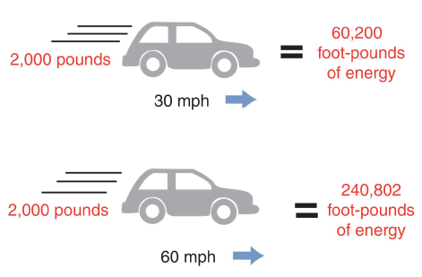
Kinetic and Potential Energy
When energy is released to do work, it is called kinetic energy.
Kinetic energy may also be referred to as energy in motion.
Stored energy is called potential energy.

Slide 9
Energy Conversion (1 of 2)
Chemical to Thermal Energy: Chemical energy in gasoline or diesel fuel is converted to thermal energy when the fuel burns in the engine cylinders.
Chemical to Electrical Energy: The chemical energy in a battery is converted to electrical energy to power many of the accessories on an automobile.
Electrical to Mechanical Energy: In an automo­bile, the battery supplies electrical energy to the starting motor, and this motor converts the electrical energy to mechanical energy to crank the engine.
Thermal to Mechanical Energy: The thermal energy that results from the burning of the fuel is converted to mechanical energy, which is used to move the vehicle.

Slide 10
Energy Conversion (2 of 2)
Mechanical to Electrical Energy: The generator is driven by the mechanical energy of the engine. The generator converts this energy to electrical energy to power the vehicle's electrical accessories and recharges the battery.
Electrical to Radiant Energy: Radiant energy is light energy. Electrical energy is converted to ther­mal energy to heat up a filament inside a light bulb to illuminate it and release radiant energy.
Kinetic to Mechanical to Electrical Energy: Hybrid vehicles have a system, called regenerative braking, that uses the energy of the moving vehicle (kinetic) to rotate a generator. The mechanical energy used to operate the generator is used to provide elec­trical energy to charge the batteries or power the electric drive motor.

Slide 11
Volume and Ratios (1 of 2)
03.03 Explain how volume, ratios, and proportions are used in automotive service.
Volume is a measurement of size and is related to mass and weight. Volume is the amount of space occupied by an object in three dimensions: length, width, and height.
Often, automotive features are expressed as ratios. A ratio expresses the relationship between two things.
An engine's compression ratio expresses how much the air and fuel mixture is compressed as a cylinder's piston moves from the bottom (BDC) to the top (TDC) of the cylinder.

Slide 12
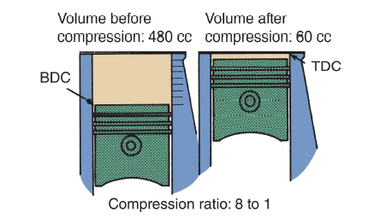
Volume and Ratios (2 of 2)
The formula for calculating the compression ratio is as follows: volume above the piston at BDC/volume above the piston at TDC

Slide 13
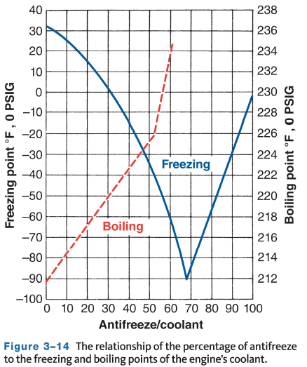
Proportions and Percentages
Ratios are also used to express the correct mixture for something. For example, engine coolant should typically be mixed with 50 percent coolant and 50 percent water when the cooling system is refilled. This is a 1 :1 ratio.

Slide 14
Automotive Forces (1 of 3)
03.04 Explain the forces that influence the design and operation of an automobile.
A force is a push or pull and can be large or small. Automotive forces include:
Forces on wheels and tires—tilting tires will result in movement and generation of force, this is the principle of resultant forces which is the basis for precise wheel alignment.
Cetrifugal/centripetal forces—Centripetal force tends to pull the object toward the center of the circle. Centrifugal force tends to push the object away from the center.

Slide 15
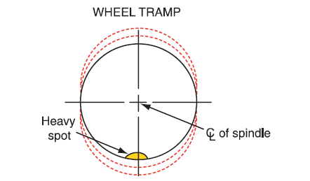
Automotive Forces (2 of 3)
Wheel and tire balance—When the weight of a wheel and tire assembly is dis­tributed equally around the center of wheel rotation, the wheel and tire have proper static balance.
Pressure is a force applied against an object and is measured in units of force per unit of surface area such as tire pressure in psi.

Slide 16
Automotive Forces (3 of 3)
Motion—when the forces on an object do not cancel each other out, they will change the objects speed, direction of motion, or both.
Inertia—the resistance to change in motion is called inertia. Another way to describe inertia is to say it is the tendency of an object at rest to remain at rest, or the tendency of an object in motion to stay in motion.
Speed—The distance an object travels in a set amount of time. Velocity is the speed of an object in a particular direction. Acceleration is the rate of increase in speed. Deceleration is the rate of decrease in speed.

Slide 17
Newton's Laws of Motion (1 of 2)
03.05 Describe and apply Newton’s laws of motion to an automobile.
Newton's first law: An object at rest tends to remain at rest and an object in motion tends to remain in motion, unless some force acts on it.
  When a car is parked on a level street, it remains stationary unless it is driven or pushed.
Newton's second law: When a force acts on an object, the motion of the object will change. This change is equal to the size of the force divided by the object's mass.
  Trucks have a greater mass than cars. Because a large mass requires a larger force to produce a given acceleration, a truck needs a more powerful engine than a car.

Slide 18
Newton's Laws of Motion (2 of 2)
Newton's third law: for every action, there is an equal and opposite reaction. A practical application of this occurs when the wheel strikes a bump in the road.
  This action drives the wheel and suspension upward with a certain force, and a spe­cific amount of energy is stored in the spring. After this, the spring forces the wheel and suspension downward with a force equal to the initial upward force caused by the bump.

Slide 19
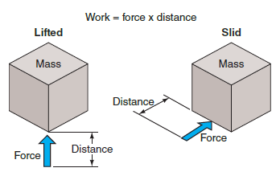
Work (1 of 2)
03.06 Define work and how it applies to vehicle operation.
When a force moves a mass a specific distance, work is a done.
When work is accomplished, a mass may be lifted or pushed against a resistance or opposing force.
Work is equal to the applied force multiplied by the distance the object is moved (force x distance = work).

Slide 20
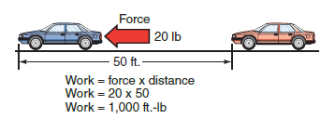
Work (2 of 2)
Work is measured in foot-pounds, watts, or Newton-meters.
For example, if a force moves a 3,000-pound car 50 feet, 150,000 foot-pounds of work was done.
Or another example as shown below, 20 pounds moved 50 feet illustrates 1,000 foot-pounds of work.

Slide 21
Discussion
Newton's first law: An object at rest tends to remain at rest and an object in motion tends to remain in motion, unless some force acts on it.
Have a class discussion while providing several examples of how this law applies to automobiles and how it is used.

Slide 22
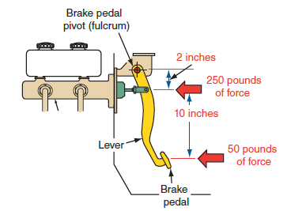
Simple Machines
A machine is any device used to transmit a force, and in doing so, changes the amount of force and/or its direction. Common examples in automotive include:
  Pulleys
  Levers
  Gears
  Wheels and axles

Slide 23
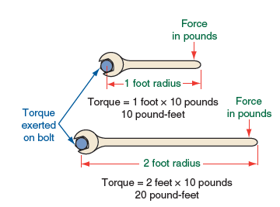
Torque
Torque is a force that rotates or turns things and is measured by the force applied and the distance trav­eled.
The technically correct unit of measurement for torque is pounds per foot (lb-ft.). However, it is rather common to see torque stated as foot-pounds (ft.-lb). In the metric, or SI, system, torque is stated in Newton-meters (N-m) or kilogram-meters (kg-m).

Slide 24
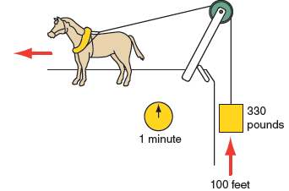
Horsepower
Horsepower is the rate at which torque is produced. James Watt is credited with being the first person to calculate horsepower and power.
He measured the amount of work a horse could do within a specific time. A horse could move 330 pounds 100 feet in 1 minute.

Slide 25
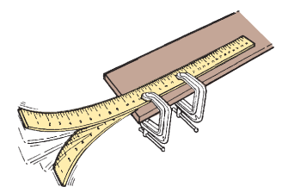
Vibrations
When an object oscillates, it vibrates.
How many times the vibration occurs in 1 second is called frequency expressed in hertz (Hz).
The amplitude of the vibration it its intensity or strength.
Vibrations occur in vehicles and may be serviced for vibration concerns.

Slide 26
Sound (1 of 2)
03.07 Describe the origins of sound, noise, and vibration.
Vibration results in the phenomenon of sound.
In air, the vibrations that cause sound are trans­mitted as a wave between air molecules; many other substances transmit sound in a similar way. A vibrating object causes pressure variations in the surrounding air.
The distance between each compression of a sound wave is called its wavelength.

Slide 27
Sound (2 of 2)
Certain terms are used to describe sound:
  The pitch of a sound is based on its frequency. The greater the frequency, the higher the pitch.
  A decibel is a numerical expression of the loud­ness of a sound.
  An overtone is an additional tone that is heard because of the air waves of the original tone.
  Harmonics result from the presence of two or more tones at the same time.

Slide 28
Noise
Noise is any unwanted signal or sound.
It can be random or periodic.
To identify the source of a noise, it is important to remember that sound or noise is a vibration and the vibration may be traveling through other components. Therefore, the source of the noise is not always where it may appear.
In automotive we may prevent or reduce noise by making the component make less noise, or by more high tech methods such as noise cancelation systems which produce a similar sound but out of phase with the unwanted noise.

Slide 29
Knowledge Check (1 of 2)
What is the difference between a sound and a noise?

Slide 30
Knowledge Check Answer (1 of 2)
What is the difference between a sound and a noise?
Answer: A noise is specifically defined as an unwanted sound.

Slide 31
Laws of Hydraulics
03.08 Explain the laws of hydraulics.
Hydraulics is the study of liquids in motion. Liquids will predictably respond to pressures put on them which allows hydraulics to do work.
Over 300 years ago a French scientist, Blaise Pascal, determined that if you had a liquid-filled container with only one opening and applied force to the liquid through that opening, the force would be evenly distributed throughout the liquid.

Slide 32
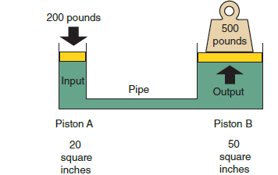
Mechanical Advantage with Hydraulics
Pascal found he could increase the force available to do work just as could be done with levers or gears.
If 200 pounds is applied to a 20 square inch input piston (A), an output piston with 50 square inches would produce 500 pounds of force, although the distance traveled will be proportionally decreased.
These findings are used in several automotive systems.

Slide 33
Behavior of Gases (1 of 2)
03.09 Explain the behavior of gases.
Three simple laws describe the predictable behavior of gases:
  Boyle's law
  Charles' law
  The pres­sure (ideal gas) law
Each of these laws describes a relationship between the pressure, volume, and temperature of a gas.

Slide 34
Behavior of Gases (2 of 2)
Boyle's law: The volume and pressure of a mass of gas at a fixed temperature are inversely proportional. If the pressure on a gas increases, its volume will decrease; likewise if the volume is increased, the pressure will decrease.
Charles' law: The volume of a gas depends on its temperature. Therefore, at a con­stant pressure, the volume of a gas will increase or decrease in relationship to its temperature. If you increase one, you increase the other.
The pres­sure (ideal gas) law: A high pressure always moves to a lower pressure.

Slide 35
Air Pressure
Because air is gaseous matter with mass and weight, it exerts pressure on the earth's surface. A 1-square-inch column of air extending from the earth's surface to the outer edge of the atmosphere weighs 14.7 psi at sea level. Therefore, atmospheric pressure is 14. 7 psi at sea level.
Atmospheric pressure may be defined as the total weight of the earth's atmosphere.
The change in atmospheric pressure is measured with a barometer and is called barometric pressure.
Vacuum is defined as the absence of atmospheric pressure. However, it is commonly used to refer to any pressure less than atmospheric pressure.

Slide 36
Heat
Heat is a form of energy. The main sources of heat are the sun, the earth, chemical reactions, electric­ity, friction, and nuclear energy.
Temperature is an indication of an object's kinetic energy.
The temperature of an object is a statement of how cold or hot an object is which is different than how much heat energy the object contains.
Heat is measured in British thermal units (Btus) and calories. One Btu is the amount of heat required to heat 1 pound of water by 1 degree Fahrenheit.

Slide 37
Heat Transfer
03.10 Identify types of heat transfer.
Convection: The transfer of heat by the movement of a heated object. Convection can be easily seen by watching a pot of water on a stove, the warm water at the bottom of the pot circulates and heats the cooler water near the top.
Conduction: The movement of heat through a material. The immense heat that results from com­bustion is absorbed by the engine and is used to push the pistons down, that heat is later transferred into the cooling system through direct contact.
Radiation: Does not rely on another material to transfer heat. The moving atoms and molecules within an object create waves of radiant energy. These waves are typically called infrared rays. You can feel this simply by putting your hand near something that is hot, the energy will be transferred into your hand.

Slide 38
Knowledge Check (2 of 2)
What type of heat transfer is the cooling system radiator passing heat from the coolant into the surrounding air?

Slide 39
Knowledge Check Answer (2 of 2)
What type of heat transfer is the cooling system radiator passing heat from the coolant into the surrounding air?
Answer: Radiation. The coolant contacts the metal in the radiator, transferring heat into the metal, then from the metal into the air that is contacting the metal.

Slide 40
Chemical Properties
03.11 Explain how chemical properties relate to automotive systems.
A catalyst is any substance that affects the speed of a reaction without itself being consumed or changed. Catalysts tend to be highly specific, reacting with one substance or a small set of substances. In a car's catalytic converter, the platinum catalyst converts unburned hydrocarbons and nitrogen compounds into products that are harmless to the environment.
Acids are compounds that break into hydrogen (H+) ions and another compound when placed in an aqueous (water) solution.
Alkalis (bases) are compounds that release hydroxide ions (OH−) and react with H+ ions to pro­duce water, thus neutralizing each other.

Slide 41
Metallurgy (1 of 2)
Metallurgy is the art and science of extracting met­als from their ores and modifying them for a partic­ular use.
An alloy is a mixture of two or more metals. Steel is an alloy of iron plus carbon and other elements.
The rusting of iron is an exam­ple of oxidation. Unlike fire, rusting occurs so slowly that little heat is produced. Iron combines with oxygen to form rust.

Slide 42
Metallurgy (2 of 2)
Hardening is a process that increases the hardness of a metal, deliberately or accidentally, by hammering, rolling, carburizing, heat treating, tempering, or other processes.
Carburizing hardens the surface of steel with heat. It increases the hardness of the outer sur­face while leaving the core relatively soft.
Heat treating changes the properties of a metal by using heat.
Tempering is the heat treating of metal alloys, particularly steel.

Slide 43
Electricity and Electromagnetism
03.12 Describe the properties of electricity and electromagnetism.
An electric circuit is simply the path in which an elec­tric current flows. Electrons can be moved around a circuit by electrostatic forces.
A circuit usually con­sists of a conductive material, such as a metal, where the electrons are held very loosely to their atoms, thus making electron movement possible.
There are three terms every technician must understand with regard to electricity; voltage, current, and resistance.

Slide 44
Electricity
Voltage: The strength of the electrostatic force.
Current: The movement of the electric charge. The higher the voltage, the greater the current will be. But the current also depends on the thickness, length, temperature, and nature of the materials used as a conductor.
Resistance: Electrical resis­tance opposes the flow of electric current.

Slide 45
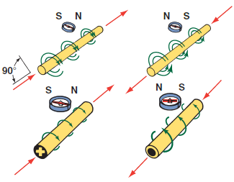
Electromagnetism
Electrical current will produce magnetism that affects other objects in the same way as permanent magnets.
The arrangement of force lines around a current-carrying conductor, its magnetic field, is circular.
When a coil of wire is wrapped around an iron bar, it is called an electromagnet.

Slide 46
Chapter Reflection
Please take a moment to compare your perception of the automotive industry before and after you studied this chapter. Then respond to the following questions in one or two paragraphs. Use 150–200 words in your reflection.
Did anything in this chapter change your thinking about automotive careers? Describe any of the basic theories and math that interest you most.
Considering all you have learned, do you feel you are able to apply basic theories and math to automotive specific systems?

